Slide 2

Intelligent Health Record Aggregation Platform
Your Online Solution to Patient Record Requests, Retrieval, and Intelligent Organization

Slide 3
Intelligent Health Record Aggregation Platform
Your Online Solution to Patient Record Requests, Retrieval, and Intelligent Organization
Medical Records Indexing

Slide 5

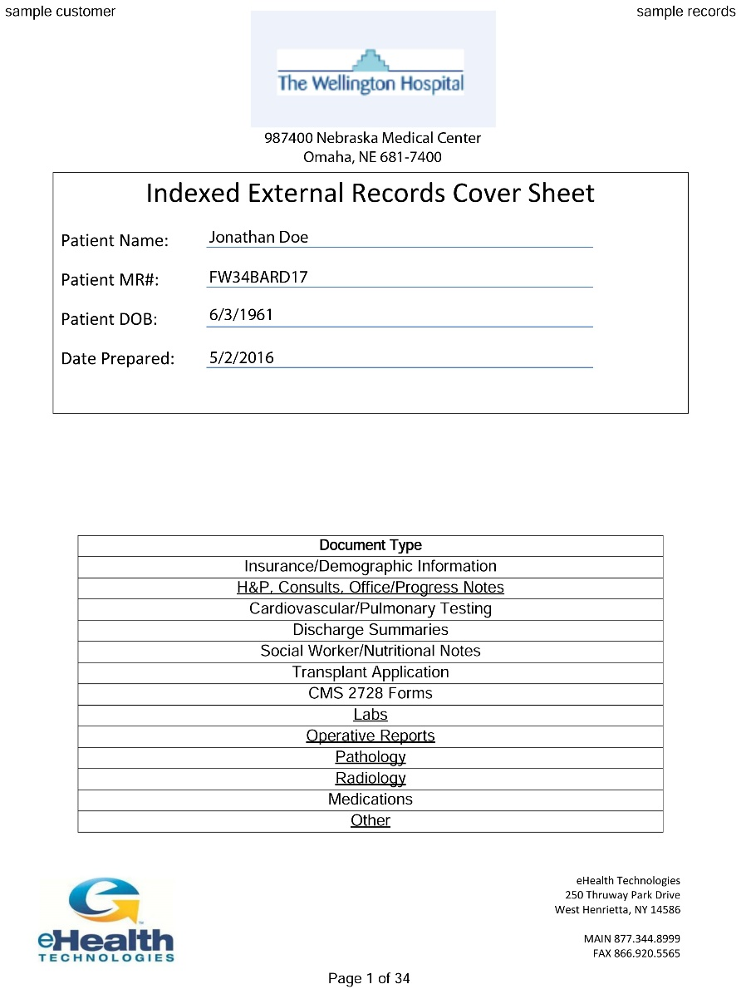
Indexing is a process by which medical records requested from the Record Aggregation Platform Referral Management Solution are complied in one searchable pdf document

Slide 7
Each Indexed Record includes:

Slide 8
Each Indexed Record includes:
The facility name and address

Slide 9
Each Indexed Record includes:
The facility name and address
The patient’s name, MR number and DOB

Slide 10
Each Indexed Record includes:
The facility name and address
The patient’s name, MR number and DOB
The date the document was prepared

Slide 12
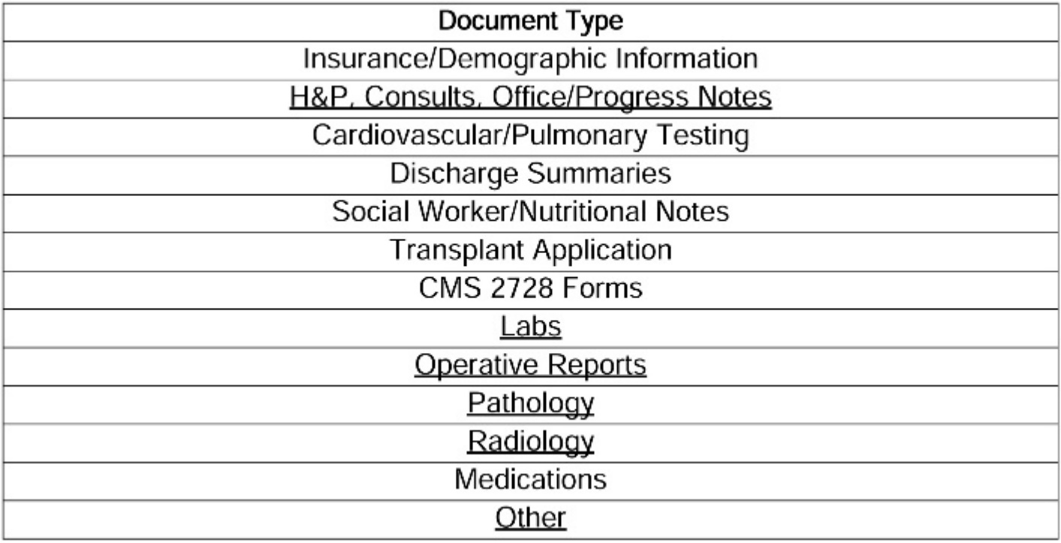
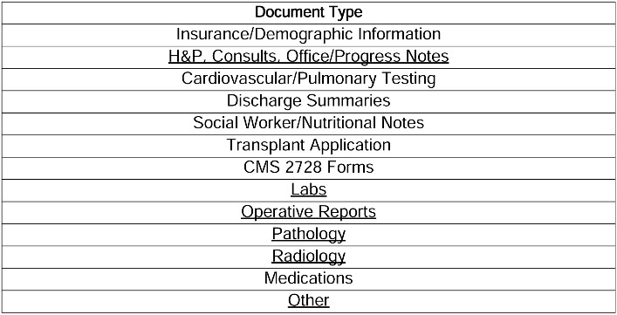
The Cover Sheet includes a predetermined list of Document Types

Slide 13
The Cover Sheet includes a predetermined list of Document Types
Only categories containing documents are underlined
Clicking on an underlined category will take you directly to the cover page of that section
The Cover Sheet includes a predetermined list of Document Types
Only categories containing documents are underlined
The Cover Sheet includes a predetermined list of Document Types

Slide 14
The Cover Sheet includes a predetermined list of Document Types
Only categories containing documents are underlined
Clicking on an underlined category will take you directly to the cover page of that section

Slide 16
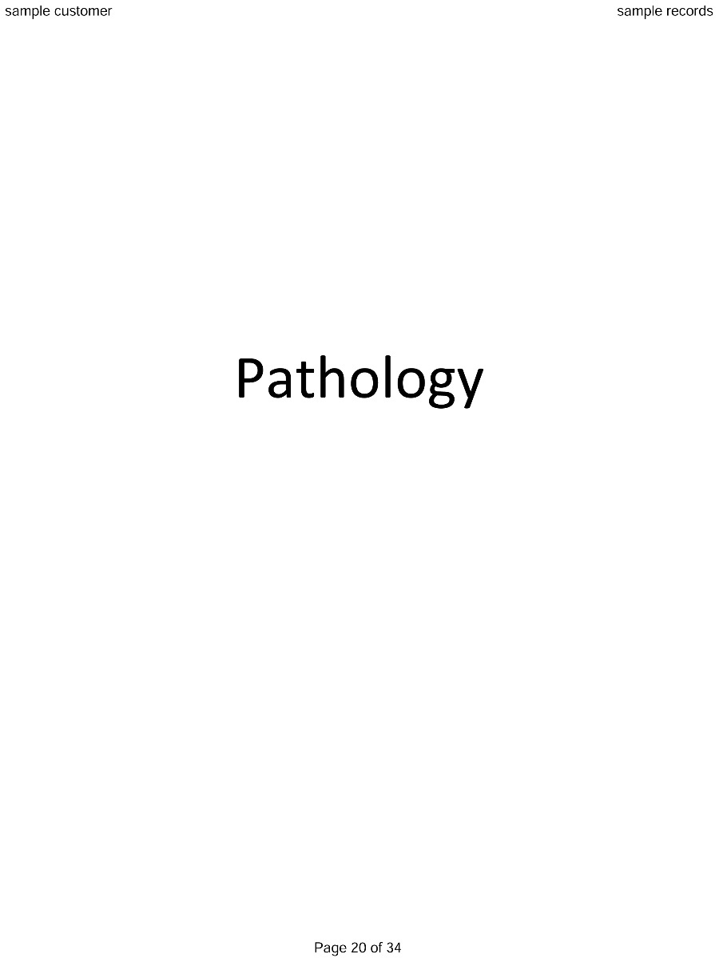
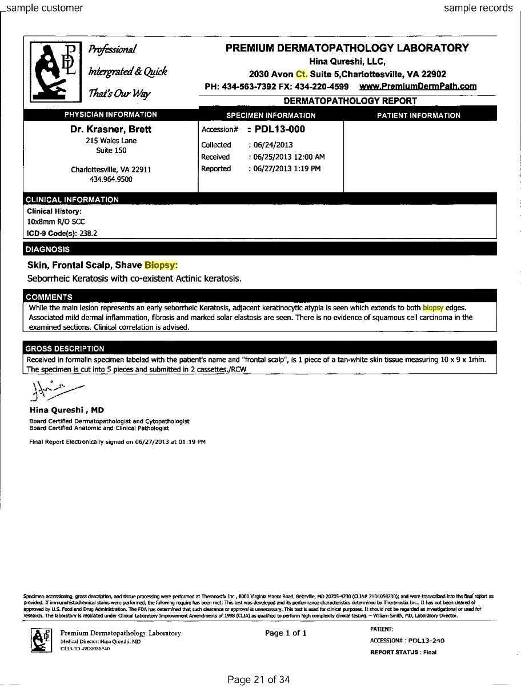
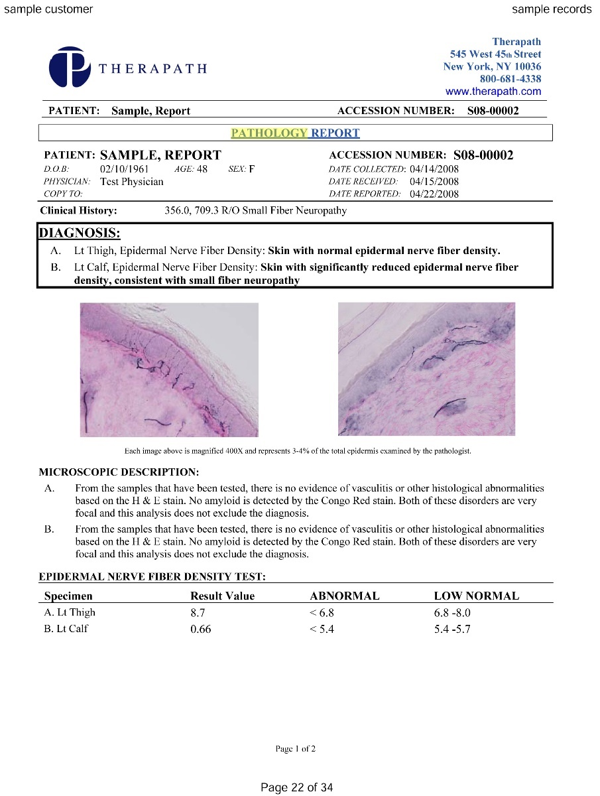
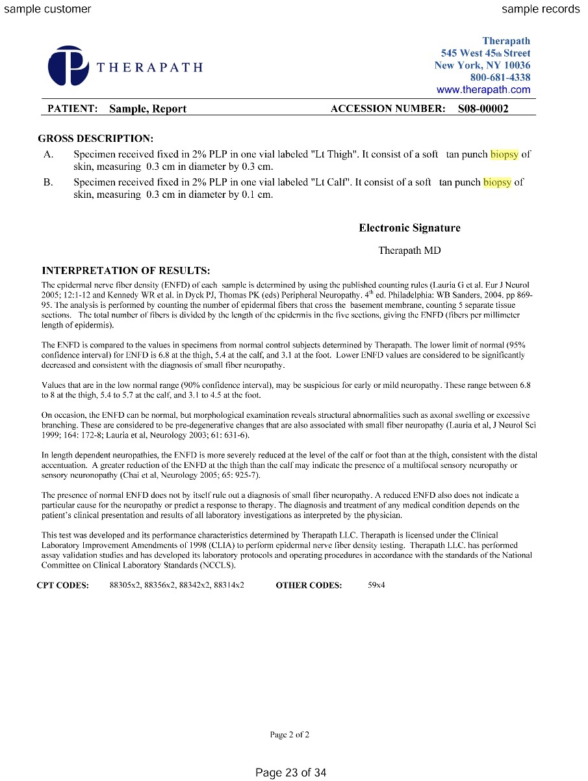
Records in each category are grouped in Reverse Chronological Order, with the most recent document first

Slide 18
All Indexed Documents are set up with several ways to find data

Slide 19
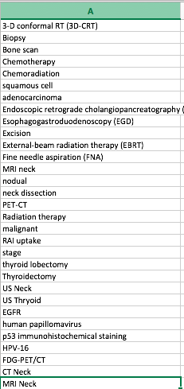
A list of Key Words is created per department.

Slide 20
A list of Key Words is created per department.
A list of Key Words is created per department. These words are then highlighted and searchable within the final Indexed Patient Record via Bookmarks

Slide 21
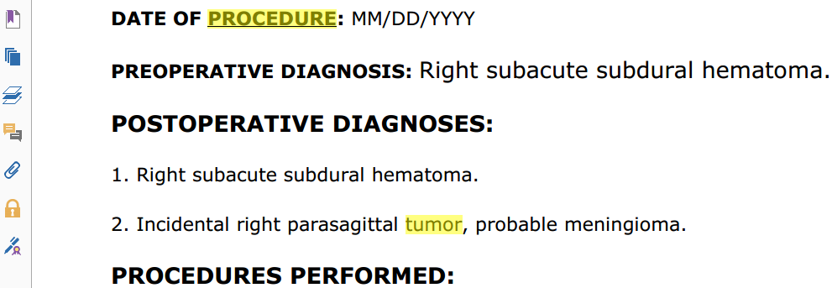
The Key Word Bookmark Pane can be accessed by clicking on the Bookmark Icon in the upper left hand corner, or by pressing Control+B on the keyboard

Slide 22
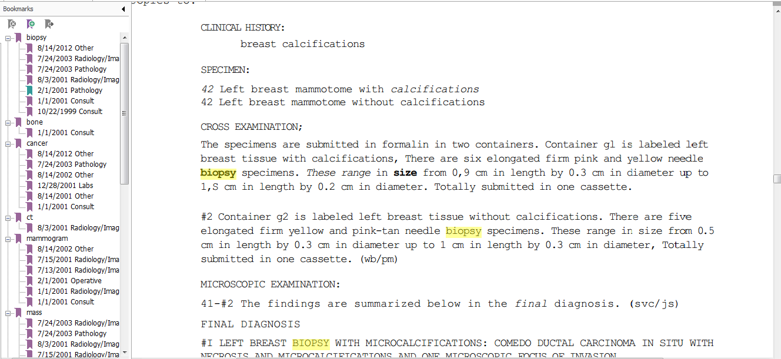
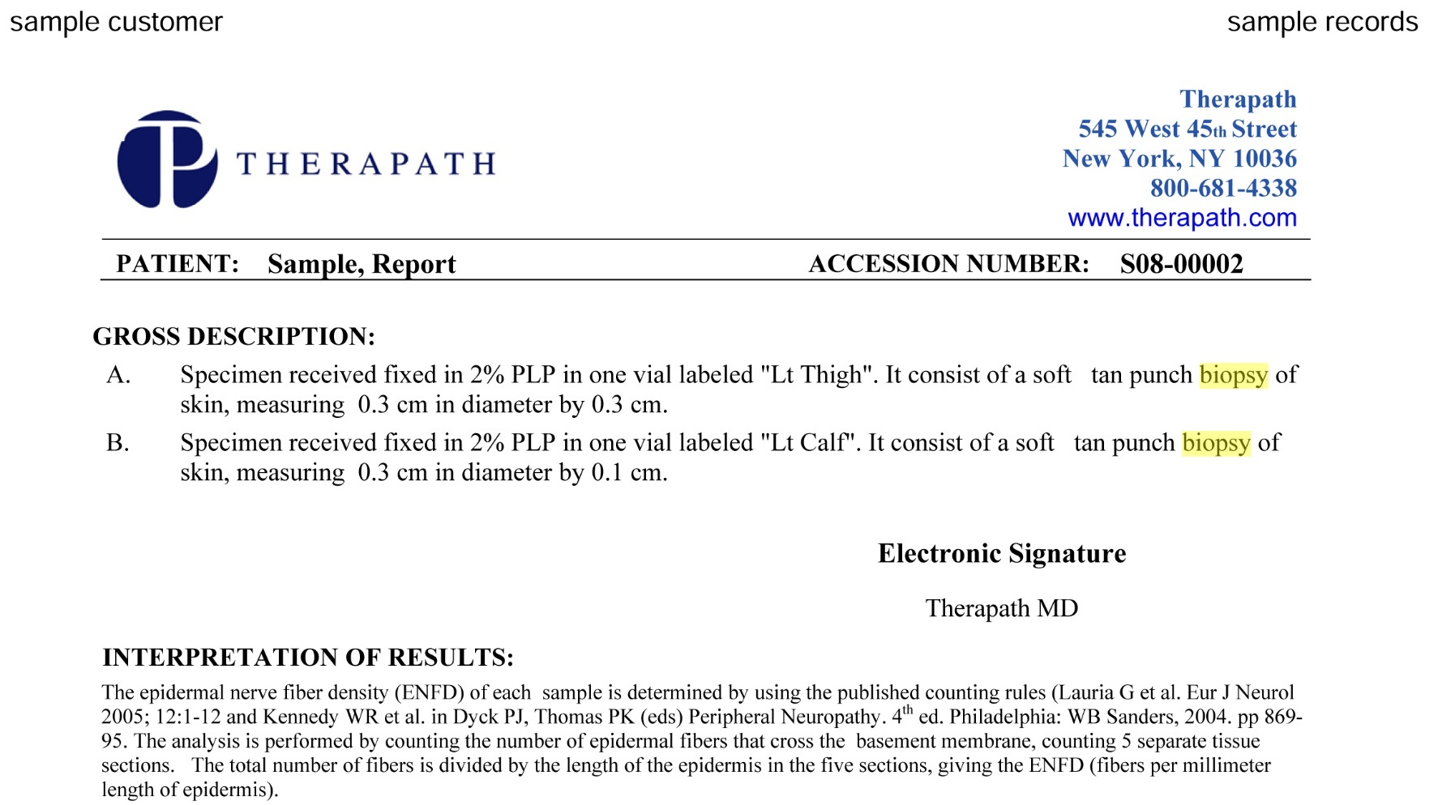
Key Words will be listed on the left and highlighted within the text. Clicking on a Key Word will take you directly to it within the body of the document

Slide 23
The entire Indexed document goes through an OCR (Optical Character Recognition) process. This creates a fully searchable document

Slide 24
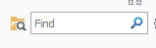
You can search the entire document by pressing Control+F on your keyboard to open the Find Tool

Slide 25
Enter the text you want to search for and press Enter (or Return) on your keyboard
Impression

Slide 26
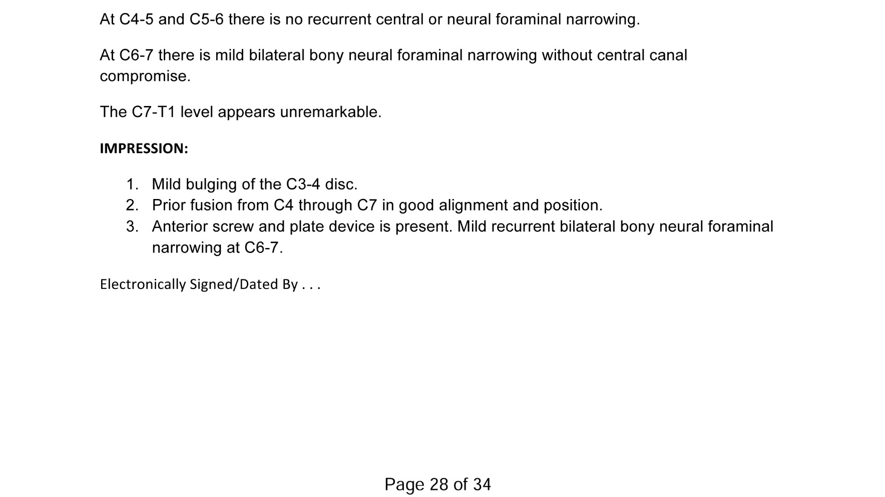
The searched text is highlighted and selected – ready for you to copy and paste to another document

Slide 28
It is important to review the Key Words and Templates with clinicians once the system has been in place for approximately one month. This will ensure optimal efficiency and workflow

Slide 30
If you have any questions please contact:
Michelle.Donowsky@ehealthtechnologies.com (585) 317-2546

